Slide 1
Web Mapping and Analysis
Dr Alex Singleton
Department of Geography and Planning
www.alex-singleton.com

Slide 2
Overview and Structure
10 Weeks
10 Lectures - 1hr
10 Labs - 2hr
Website
http://geographicdatascience.com/WebMapping/
2 Assignments
Due end week 7
Due end week 12

Slide 3
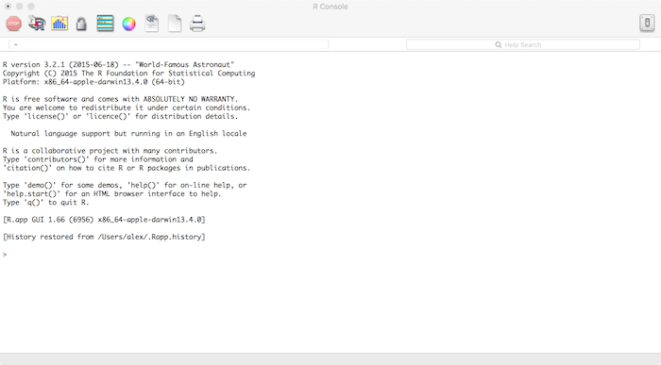
Week 1: An Introduction to Web Mapping and Analysis
Module Tour
History of the Geoweb
Practical
An Introduction to the R Language
Basics of R & data manipulation

Slide 4
Module Tour
Week 1:
Lecture: An Introduction to Web Mapping and Analysis
Practical: An Introduction to the R Language
Week 2:
Lecture: R for Mapping
Practical: Using R for Mapping and Visualization
Week 3:
Lecture: The Anatomy and Social Science of the Internet
Practical: Linking R to the Web (Mapping and Analysis)
Week 4:
Lecture: The Internet as a Geographic Data Source
Practical: Linking R to the Web (Data)

Slide 5
Module Tour
Week 5:
Lecture: Shiny Web Applications
Practical: Interactive Mapping in R Pt 1
Week 6:
Lecture: Coding Basic Web Pages
Practical: Interactive Mapping in R Pt 2
Week 7:
Lecture: The Web Mapping Stack (Interfaces)
Practical: Assignment 1 Clinic
EASTER

Slide 6
Module Tour
Week 8:
Lecture: The Web Mapping Stack (Tile Servers)
Practical: An Introduction to Cartodb
Week 9:
Lecture: Lecture: Cartography and Web Mapping
Practical: An Introduction to Mapbox Studio
Week 10:
Lecture: A Gallery of Web Mapping and Analysis Applications
Practical: Assignment 2 Clinic

Slide 7
Assignment
Assignment 1:
Using R and the Police.UK API, create maps for Liverpool that illustrate how the geography of crime has changed over a 12 month period. For this assignment you will need to submit your R code and created outputs created using Rmarkdown. Additional credit will be given if an interactive map is created using Shiny. Due end Week 7

Slide 8
Assigments
Assignment 2:
Using either CartoDB or Mapbox Studio, create an Index of Multiple Deprivation Map for Liverpool. This should graphically illustrate the overall IMD decile that each Lower Layer Super Output Area is assigned, and provide additional information about the LSOA using a rollover. Due end Week 12

Slide 9
History of the Geoweb
For an overview of the history and development of the geoweb:
Haklay, M., Singleton, A., and Parker, C. (2008). Web Mapping 2.0: The Neogeography of the GeoWeb. Geography Compass, 2(6):2011–2039.

Slide 10
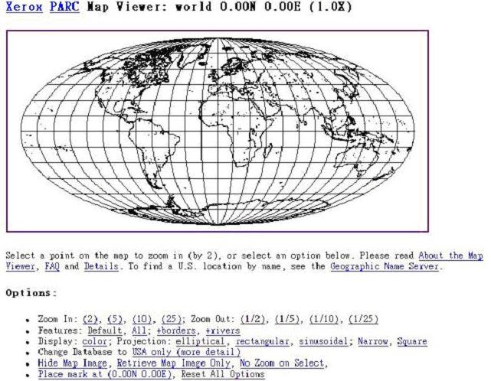
1990s
Clicking on the links sends a request to the server - inc. coordinates
Server receives request
Common Gateway Interface Script (CGI)
Server creates an image and associated HTML page
Web browser client receives HTML content
1993 - Xerox Corporation’s Palo Alto Research Center (no longer online)

Slide 11
~2005
Users accessed web mapping by three main methods
Public mapping
Web (or Internet) Mapping Servers
Geographic Web Services.

Slide 12
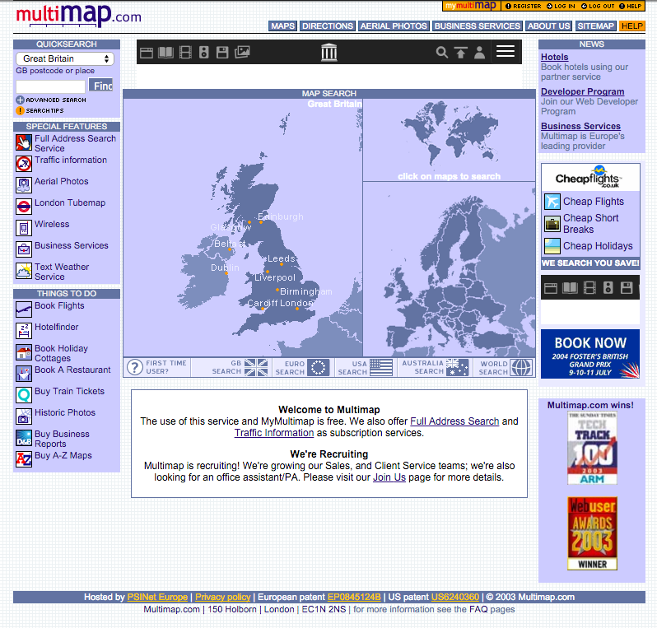
Public Mapping
Multimap - main UK mapping site - 7.3 million visitors (~2005)

Slide 13
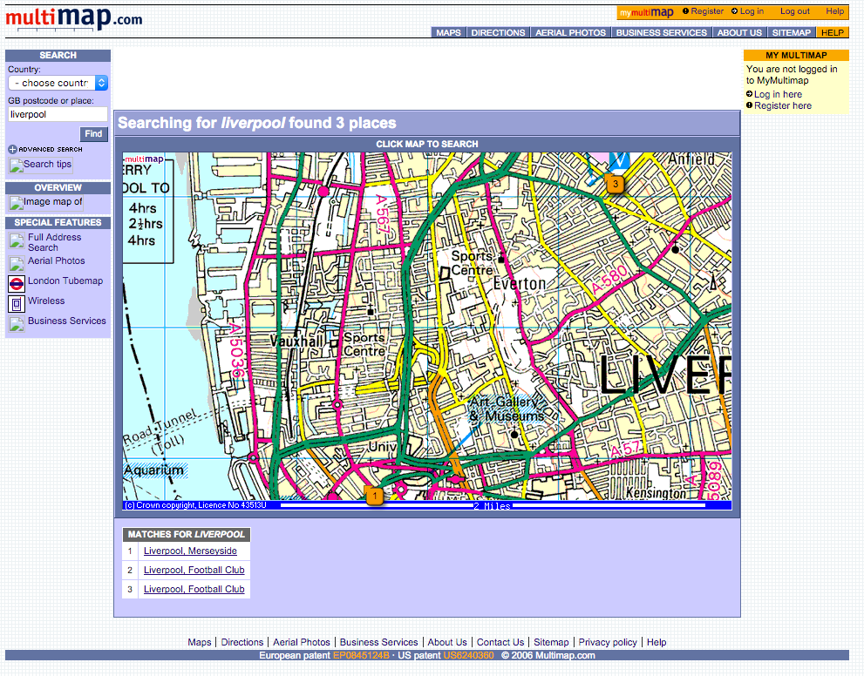
Public Mapping
Interactivity
Click to pan / zoom
Refreshed page
Map is not the main feature of the page
Constrained bandwidths
Cartography very similar to print

Slide 14
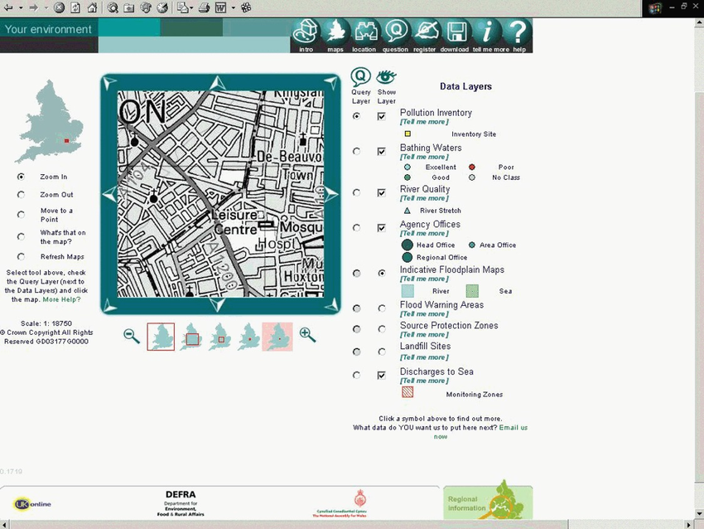
Web (or Internet) Mapping Servers
Web Mapping Server (WMS) software offered by many GIS vendors
Work in conjunction with web mapping server
Browsing, searching, downloading and rudimentary editing capabilities
Borrows terminology from GIS (data layers, query layer, zoom in, zoom out)

Slide 15
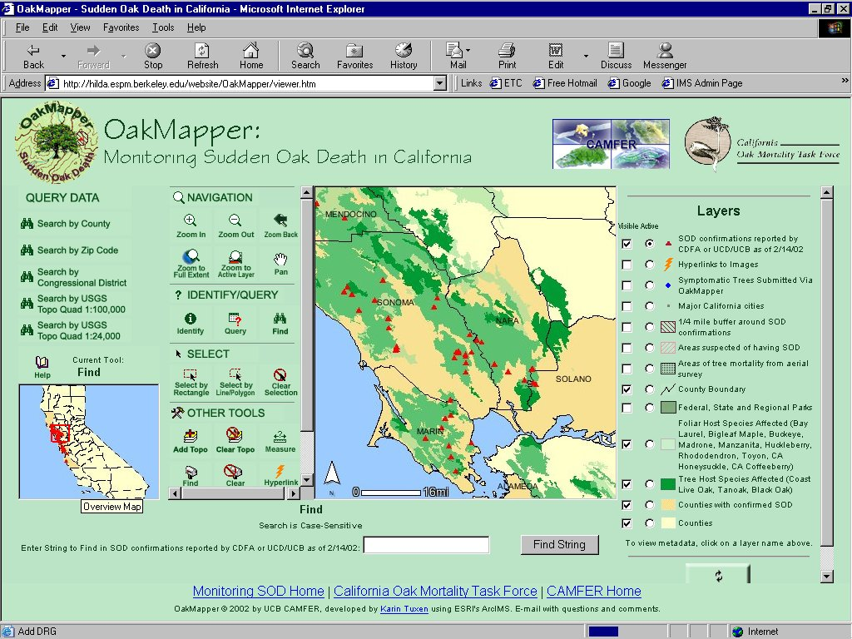
Geographic Web Services
Similar to WMS
More advanced functionality
End user interfaces were still complex

Slide 16
Open Geospatial Consortium
http://www.opengeospatial.org/Working on web mapping standards since 2000
Web Mapping Service (WMS) specifications
http://www.opengeospatial.org/standards/wms
Many compatible productsMainly in the technical domain

Slide 17
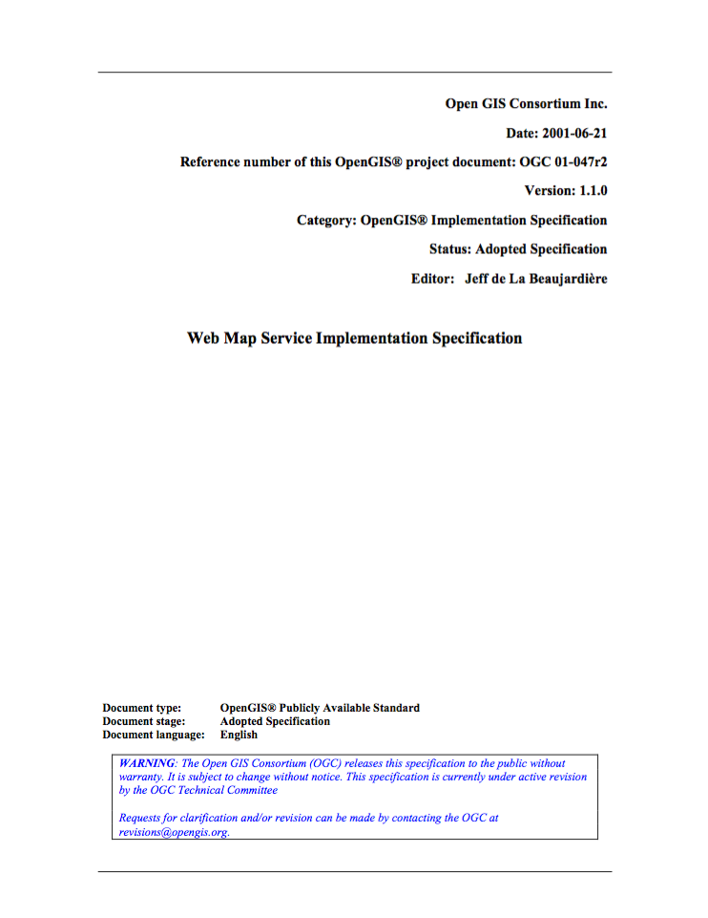
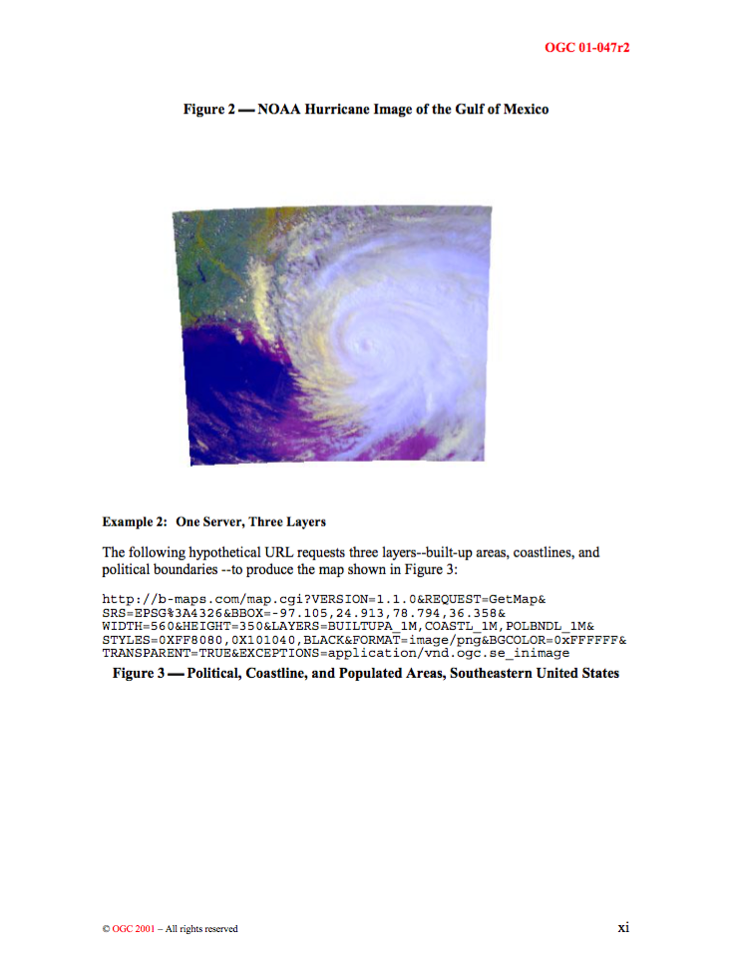
WMS Specification Version: 1.1.0

Slide 18
Elsewhere – Web 2.0
O’Reilly 2006
Web 2.0 is the business revolution in the computer industry caused by the move to the Internet as platform, and an attempt to understand the rules for success on that new platform.

Slide 19
Elsewhere – Web 2.0
Goodchild (2007)
[T]he early Web was primarily one-directional, allowing a large number of users to view the contents of a comparatively small number of sites, the new Web 2.0 is a bi-directional collaboration in which users are able to interact with and provide information to central sites, and to see that information collated and made available to others.

Slide 20

Foundations for Change (GPS)
2000 Bill Clinton, announced the removal of selective availability of the GPS signal
Enabled accuracy of 6–10 m (from 100m)
Source: gps.gov

Slide 21
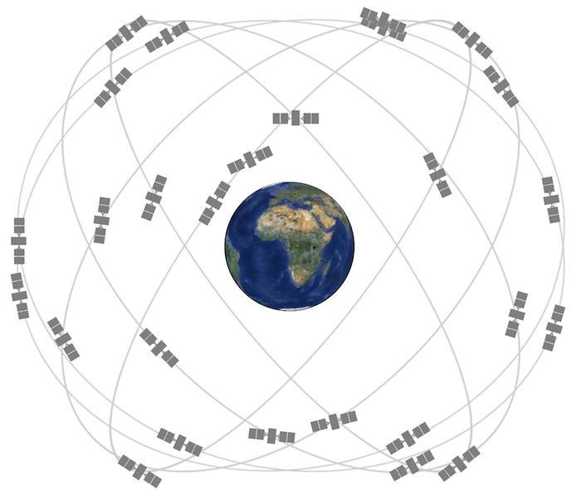
Foundations for Change (GPS)
Source: gps.gov

Slide 22
Web 2.0 Technologies and AJAX
Asynchronous JavaScript and XML (AJAX)
Web applications can send data to and retrieve from a server in the background
No need to refresh webpages
Interaction more akin to a desktop application
Interfaces changed - maps now larger
New forms of interactivity
Google Maps launches 2005

Slide 23
Google Maps
Google Maps - 71.5 million visitors (by 2007)
50,000 new websites that are based on Google Maps (by 2007)

Slide 24
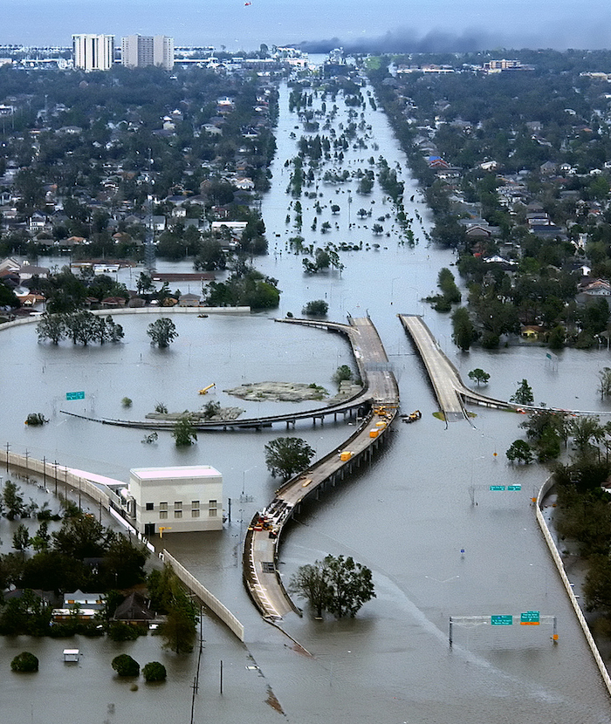
Application Programming Interfaces (API)
Enables the building of applications
“Mashups” - adding data to maps
Wider engagement - non-professionals
Source: wikipedia

Slide 25
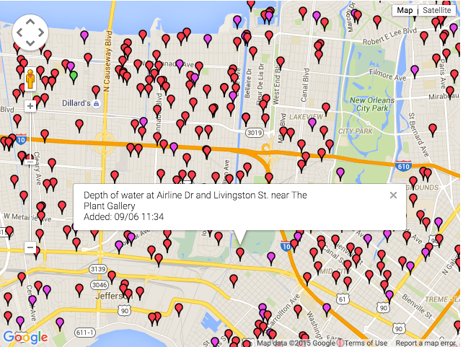
Application Programming Interfaces (API)
Source: Website was developed by Jonathan Mendez and Greg Stoll and is available online (http://gregstoll.dyndns.org/scipionus)

Slide 26
Current

Slide 27

Many thanks…
Any questions?

